Slide 1
Pipeline 3 Yichen Liu
Group 1 Final Presentation

Slide 2
Group 1 Final Presentation
Cleaning Data
I
II
III
IV
Step 1: Word Embedding
Doc2Vec
ELMo Vector
— variant according to the context
GloVe
-invariant
BERT
(huge pretraining set, SoftMax)
Step2:
WordVec
2DocVec
Step3: Classifier
XGBoost
Keras Neural Model
XGBoost /KNN/ passiveAgressive / RandomForest / ...
Pipeline 3
Evaluate

Slide 3
Pipeline 3
Group 1 Final Presentation
Why GloVe ?
Why not Word2Vec ?

Slide 4
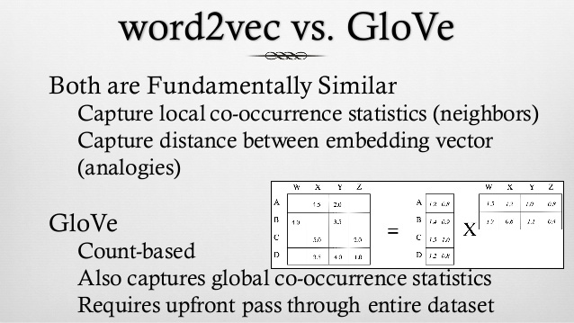
Pipeline 3
Group 1 Final Presentation

Slide 5
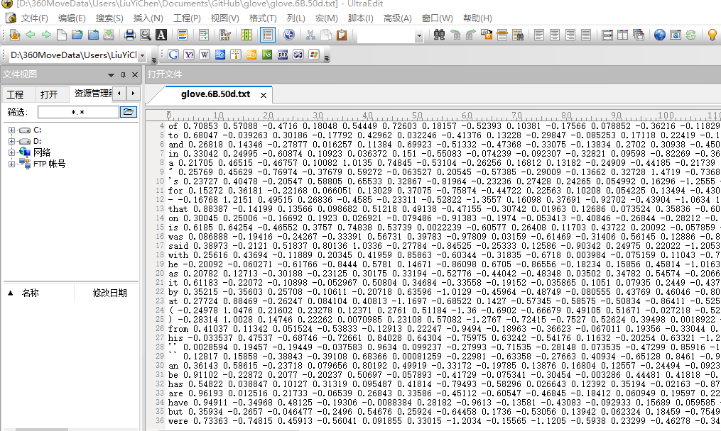
Pipeline 3
Group 1 Final Presentation

Slide 6
Pipeline 3: GloVe + KNN
Group 1 Final Presentation
Original
Document
GloVe
Embedding
KNN
Classifier
Hypertuning
Tokenization
Final
Result
Removing
Stopwords
Embedding
Classification

Slide 7
Pipeline 3: GloVe + KNN
Group 1 Final Presentation
Key Hyperparameters :
n_neighbor
Weight
p
Uniform
Distance

Slide 8
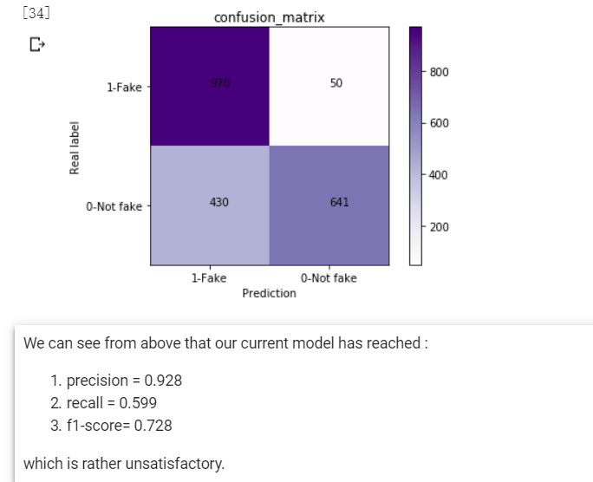
Group 1 Final Presentation
Pipeline 3: GloVe + KNN

Slide 9
Pipeline 3: GloVe + XGboost
Group 1 Final Presentation
Original
Document
GloVe
Embedding
XGboost
Classifier
Hypertuning
Tokenization
Final
Result
Removing
Stopwords
Embedding
Classification

Slide 10
Pipeline 3: GloVe + XGboost
Group 1 Final Presentation
Key Hyperparameters :
max_depth
learning_rate
n_estimators
min_child_
weight
max_delta_ step
subsample
colsample_bytree
reg_alpha
reg_lambda
scale_pos_
weight

Slide 11
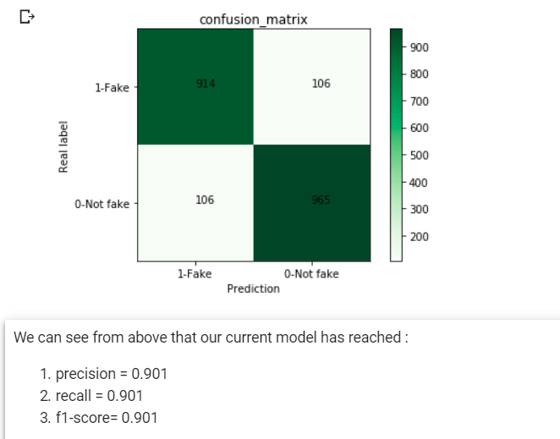
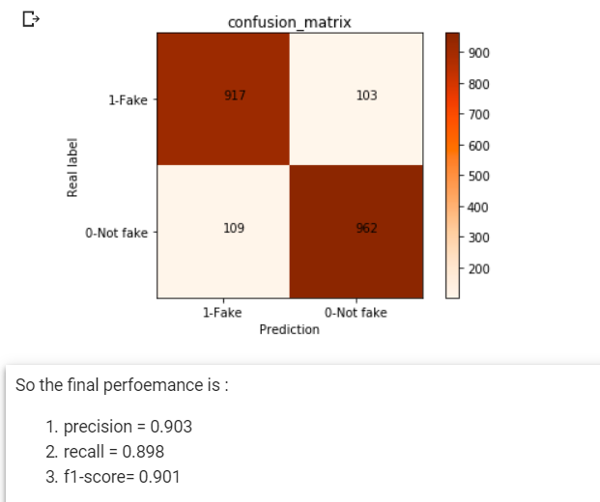
Pipeline 3: GloVe + XGboost
Group 1 Final Presentation

